Slide 1
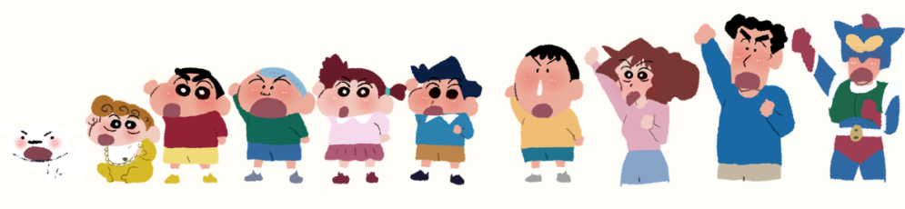
Remeber to express your gratitude
小组成员（按汇报顺序排序）：卫雨晴 韩佳伶 苏凡凡 李恩书

Slide 2
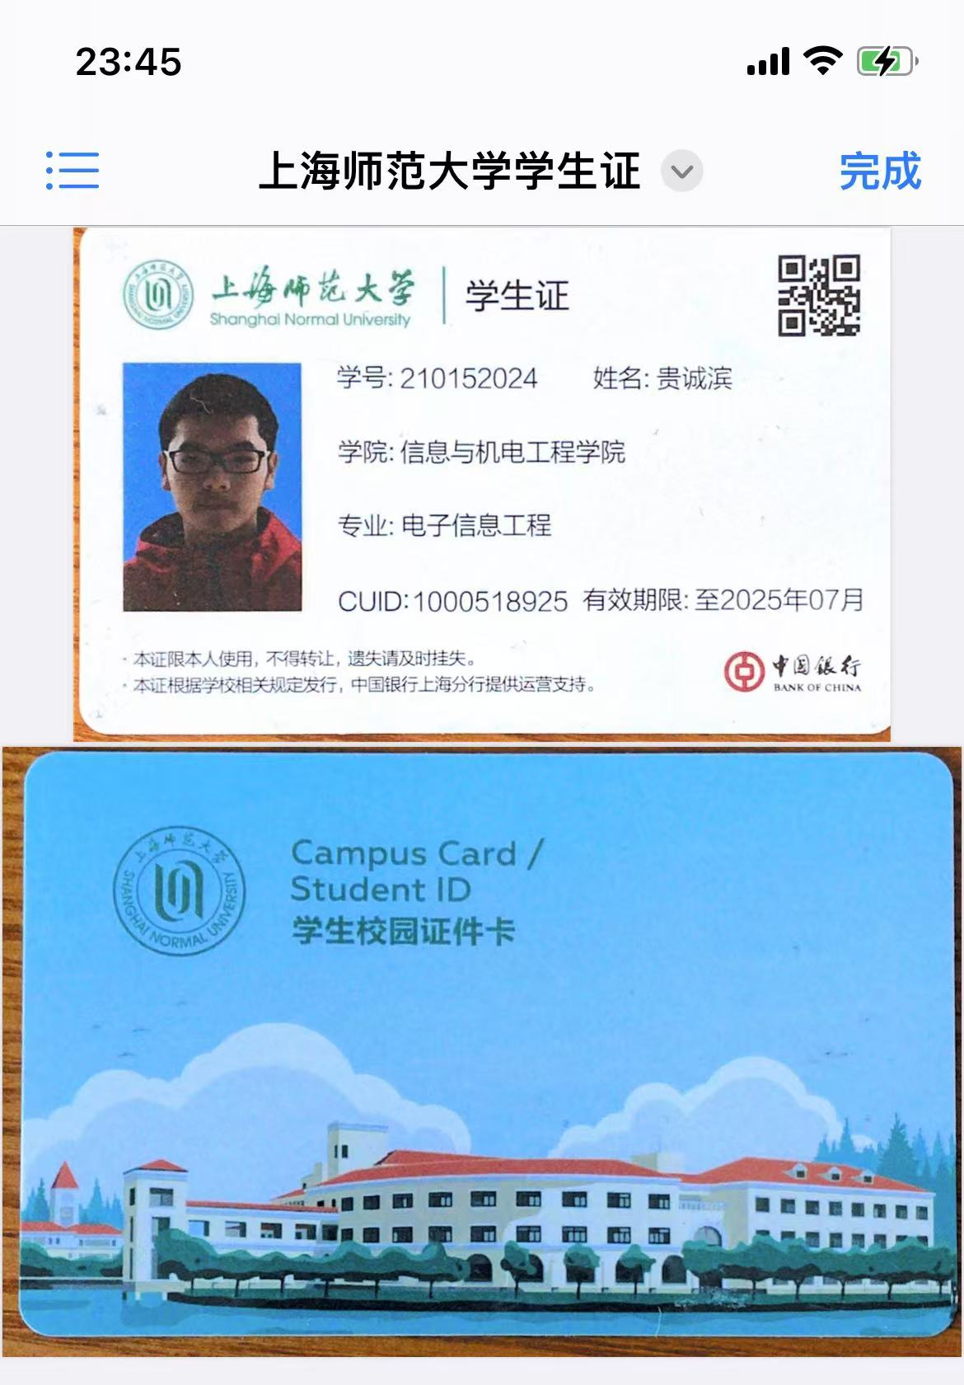
张璟轩

Slide 3
CONTENTS
01.Part One
Always be grateful to those around you
02.Part Two
·The importance of a keen awareness of expressing gratitude
·a sharp awareness of gratitude
03.Part Three
What advice do you have for college students?

Slide 4
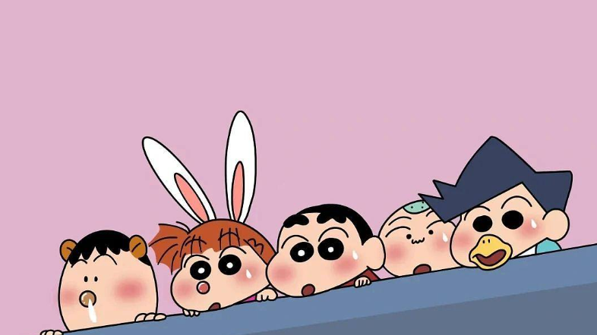
01
Always be grateful to those around you

Slide 5
Are you always grateful to others?

Slide 6
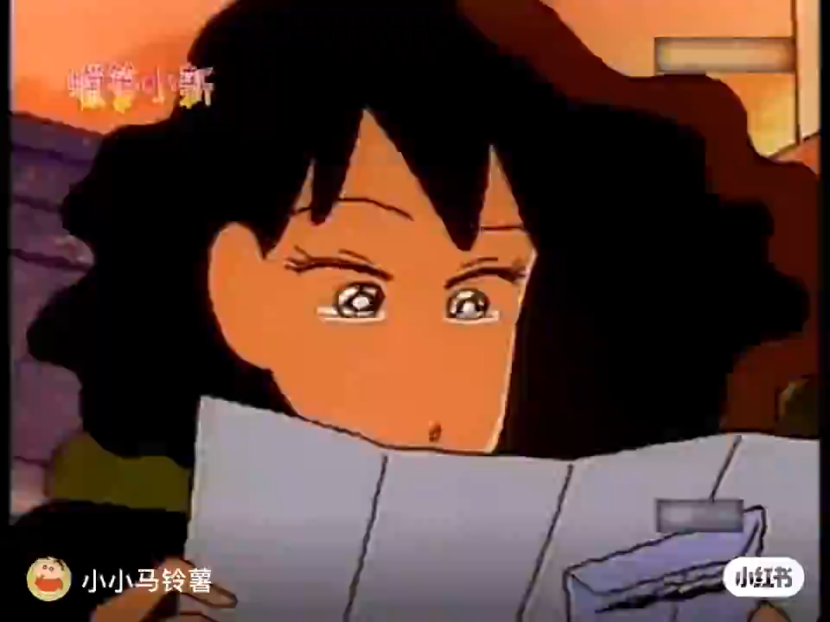

Slide 7
Though naughty, Xin has a warm side. He wrote a letter thanking Mei Ya for her care, an act that showed the tenderness of his heart. In life, we often neglect to express gratitude, and Xiao Xin's action reminds us that we should value the efforts of others and respond with gratitude.

Slide 8
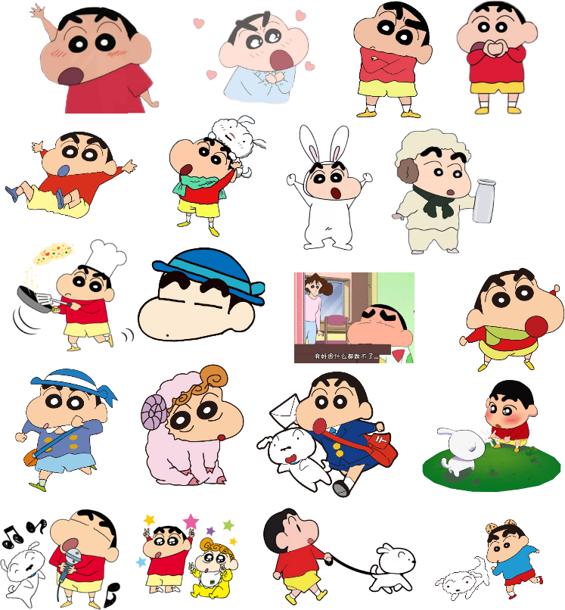
The meaning of Gratitude in Relationships
Gratitude plays an extremely important role in relationships.
Among friends
deepening the friendship between each other
In the workplace
form a positive working atmosphere and reduce conflict and conflict

Slide 9

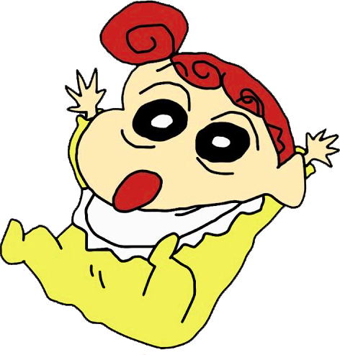
Expression of gratitude
The most common and direct are sincere words of thanks.a sincere "thank you so much, I don't know what I would do without you" will show the other person that you are sincere.
Rewarding behavior is also a sign of gratitude , this is a practical way to show gratitude.

Slide 10




The effect of gratitude
Personal Impact
gain a sense of inner satisfaction
Social impact
create a harmonious atmosphere
Impact on others
they can feel deeply recognized and respected

Slide 11
02
a sharp awareness of gratitude
.

Slide 12


Slide 13
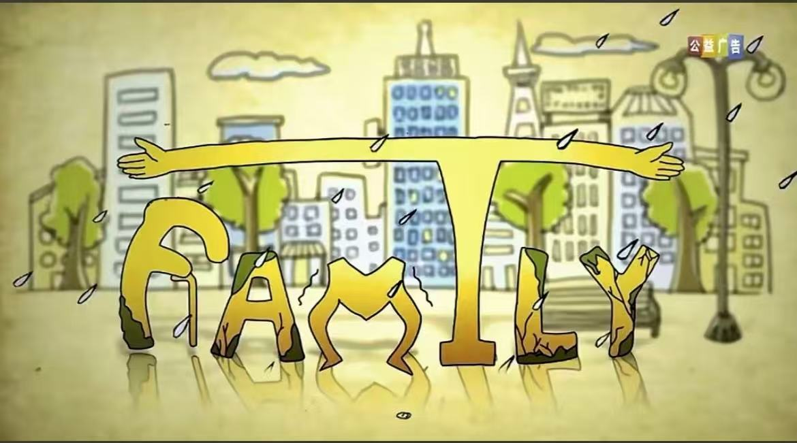

Father and mother I love you
What is family? It's father and mother I love you. One day, we will also grow up to be parents and protect our children from the storms of life.

Slide 14
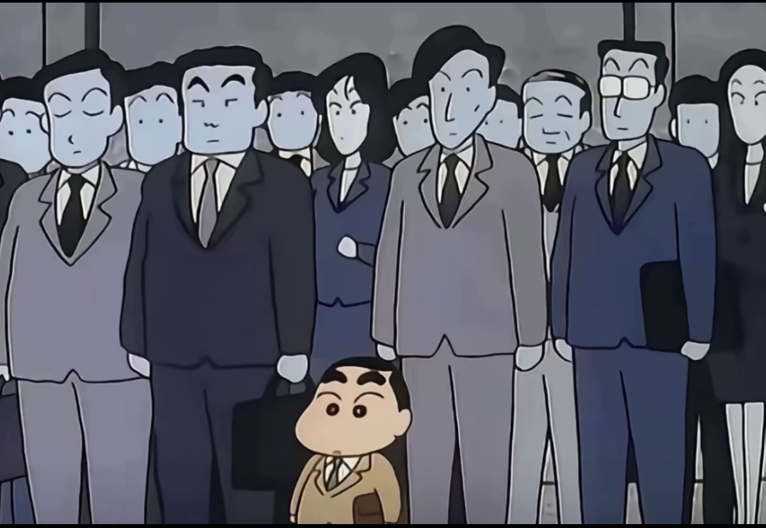
The journey of gratitude learned from living expenses after going to college:
Through this experience, I have come to realize how important it is to have a keen heart to perceive the little kindnesses in life.
Don't feel shy to express your gratitude; always be brave enough to speak out your appreciation!
不要觉得难以启齿，一定要勇敢说出自己的感激！
Personal experience

Slide 15
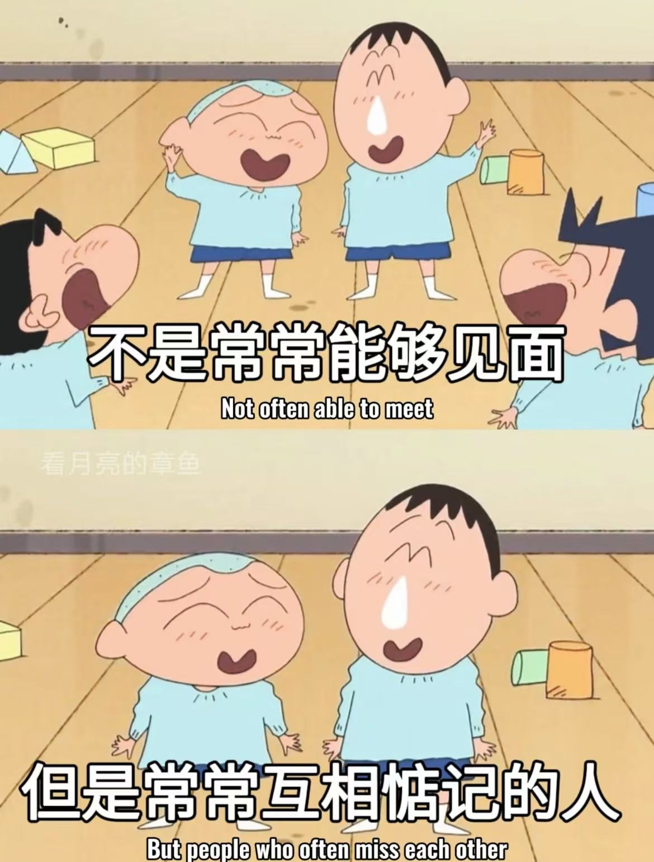
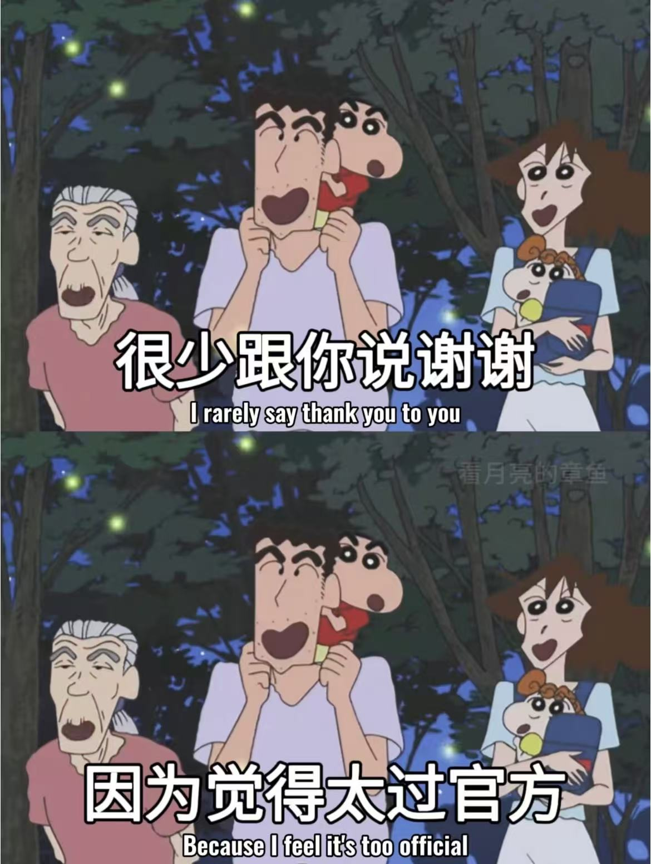
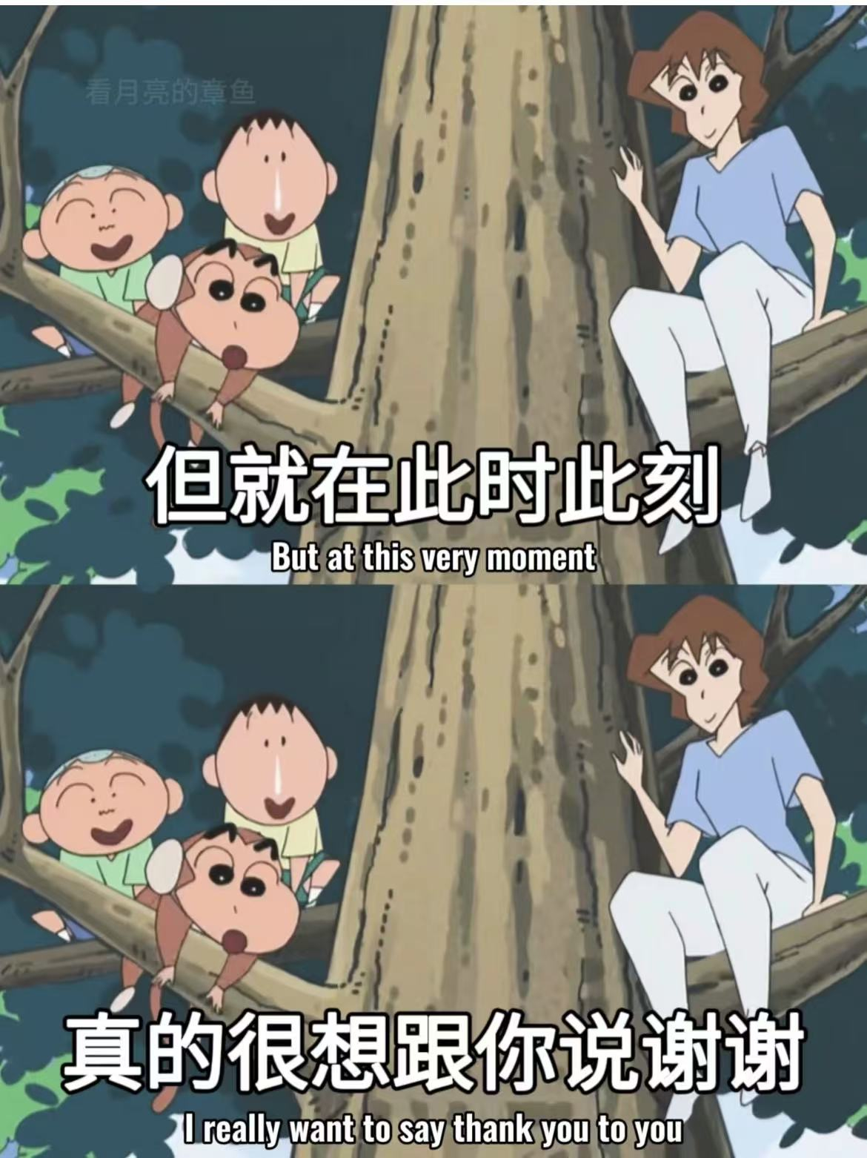
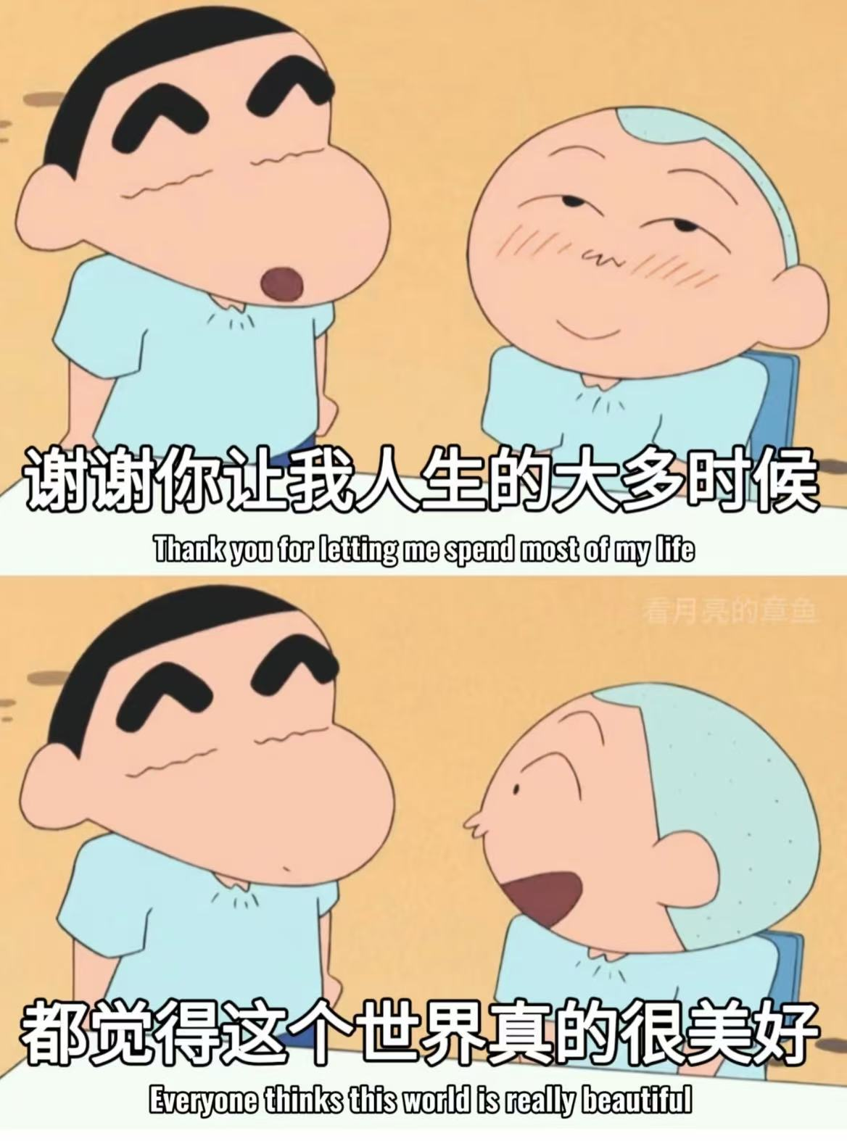
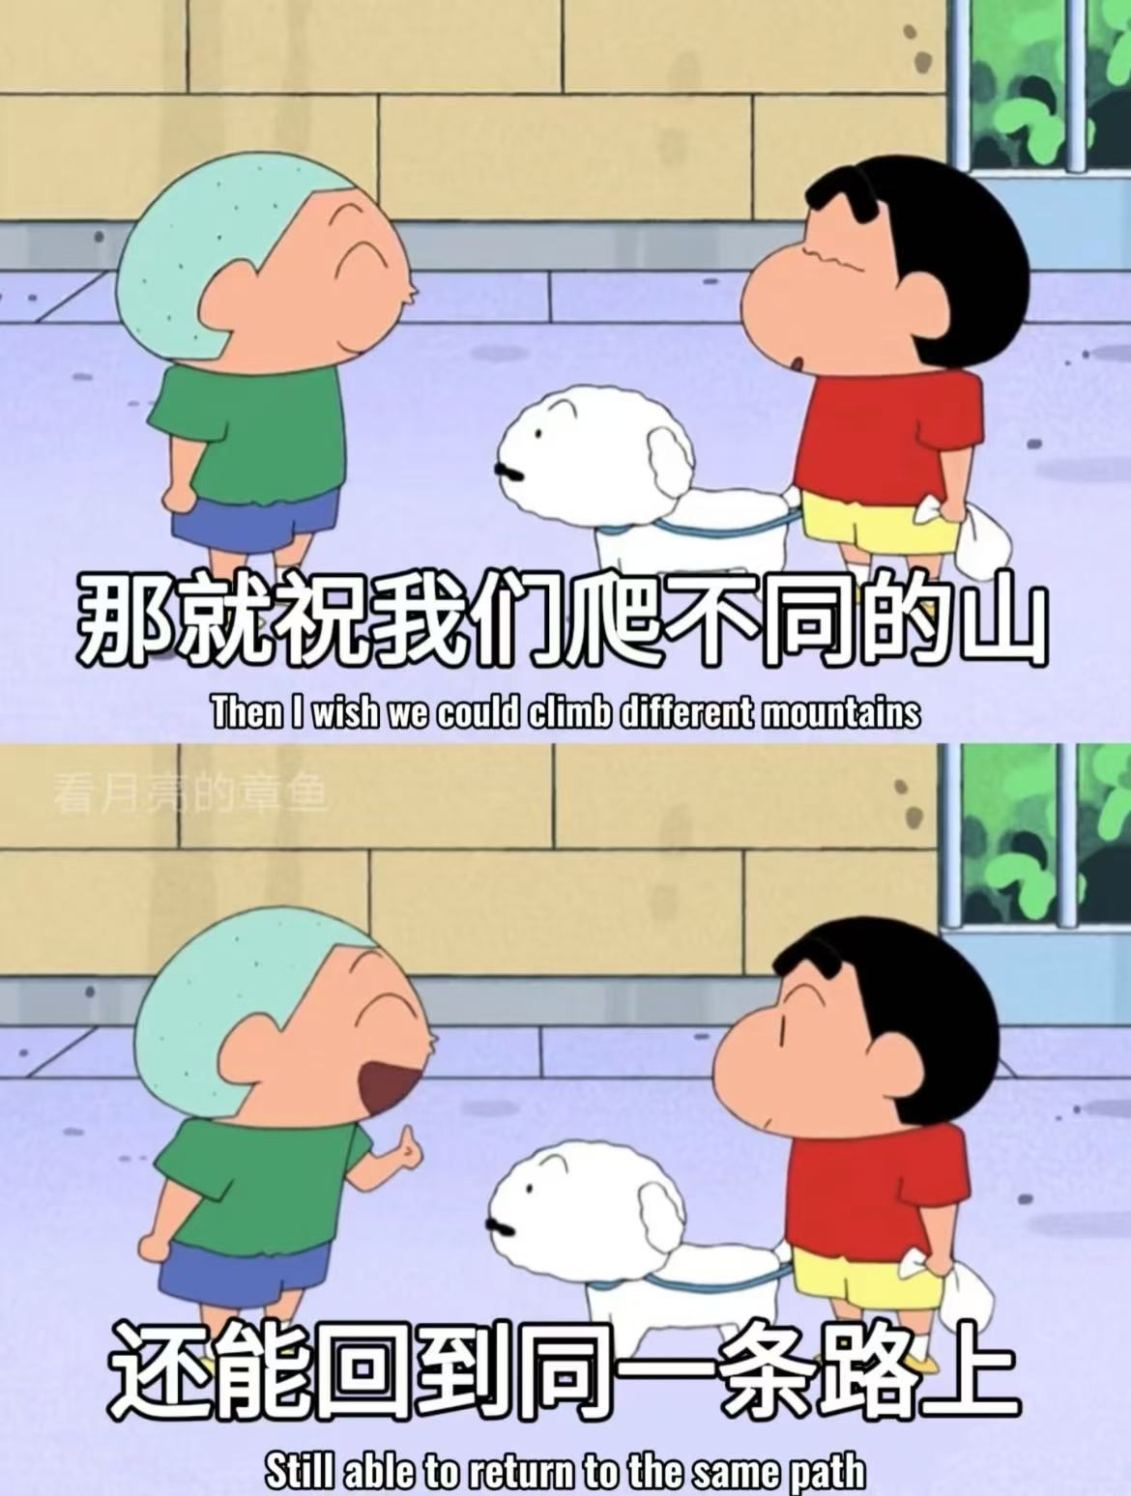
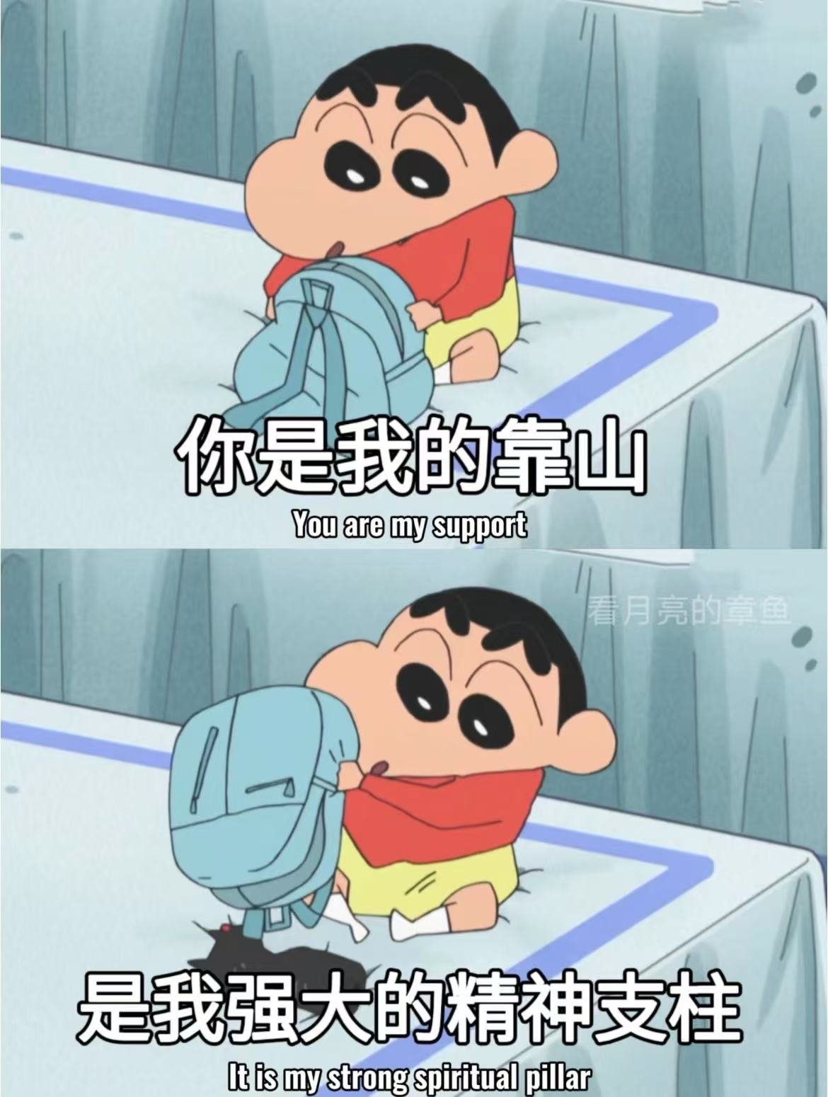
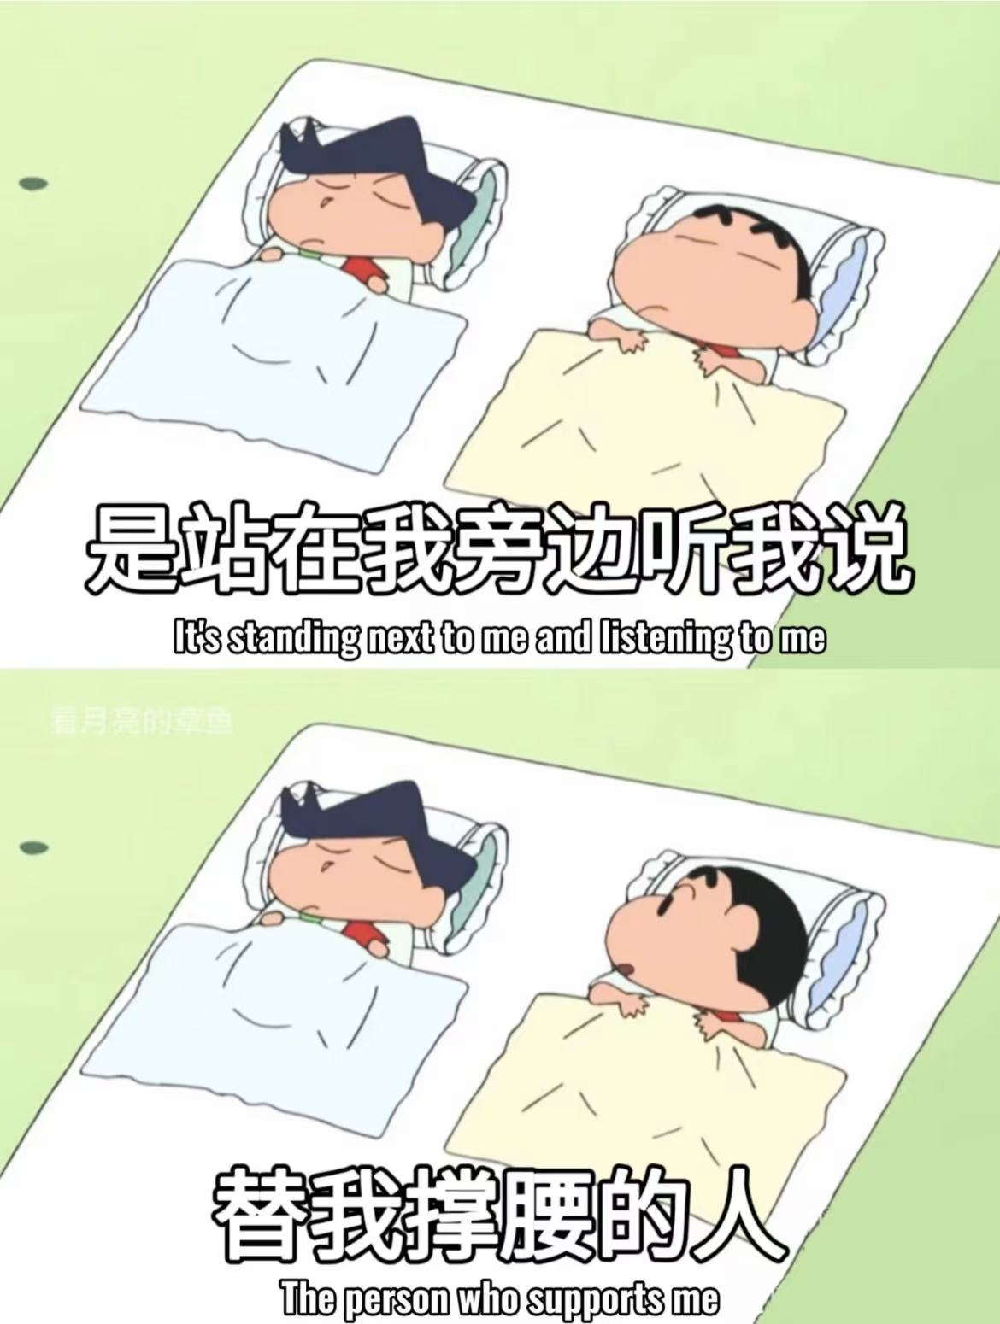
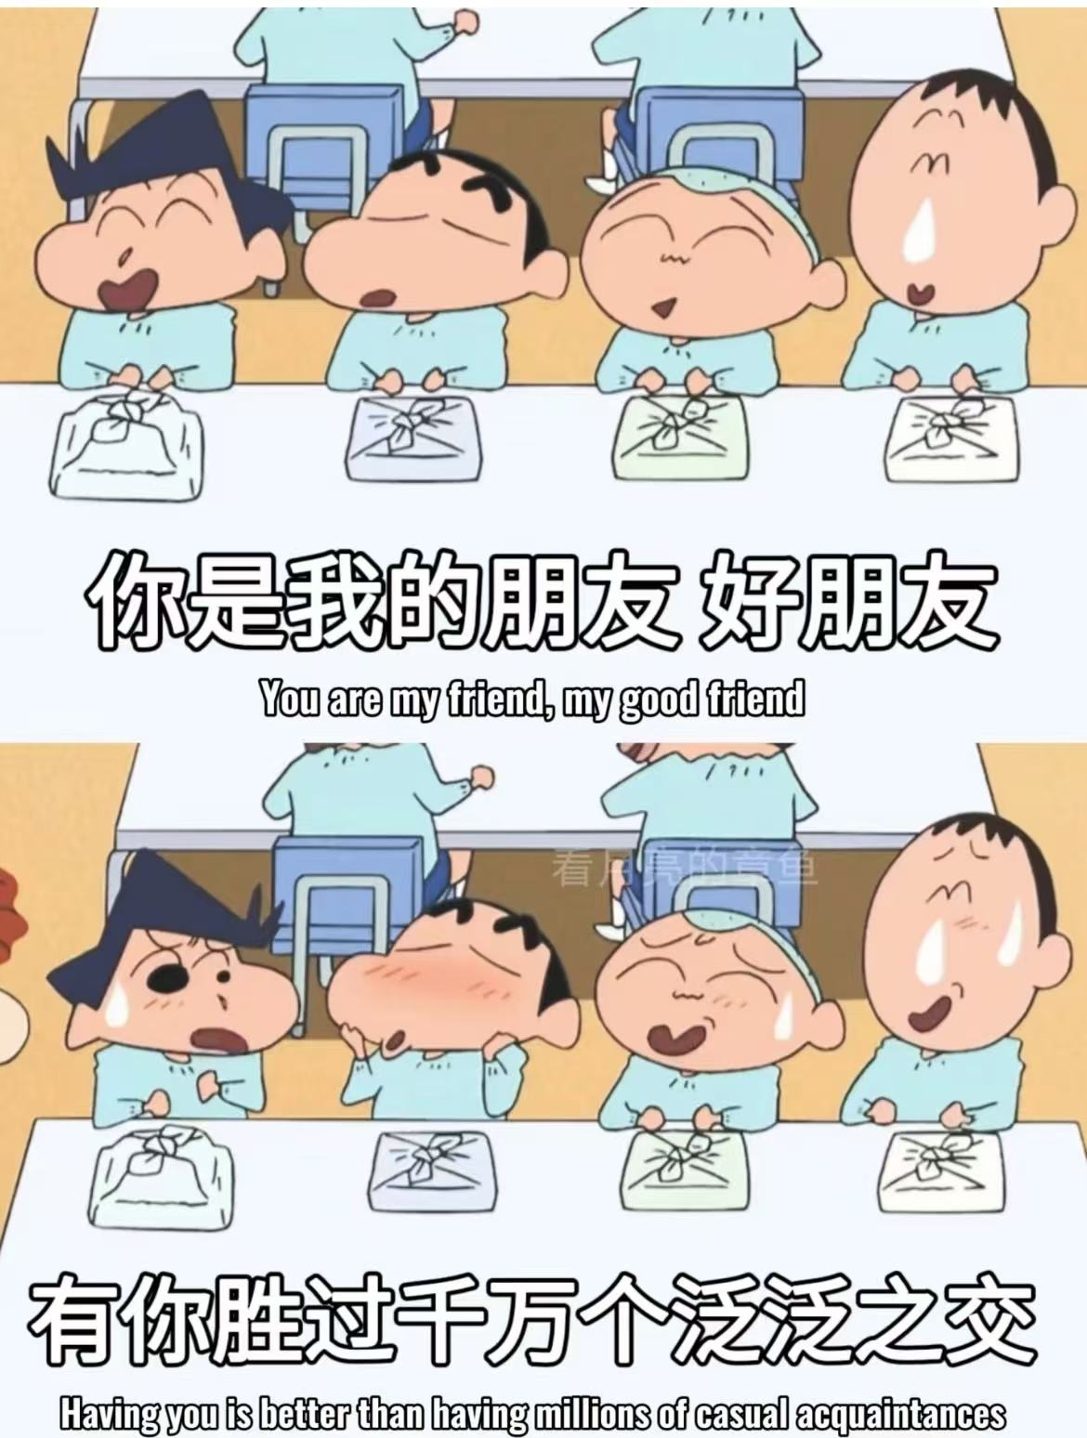









Slide 16
02
The importance of a keen awareness of expressing gratitude

Slide 17
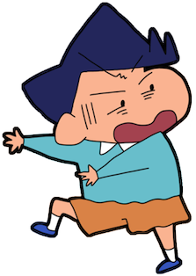
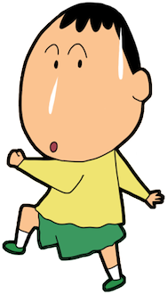

01
Sociocultural dimensions
02
Personal development dimension

Slide 18
In today's diverse social and cultural background, our exchanges are becoming more and more complex. In such an environment, a keen awareness of expressing gratitude to others is crucial.

Slide 19
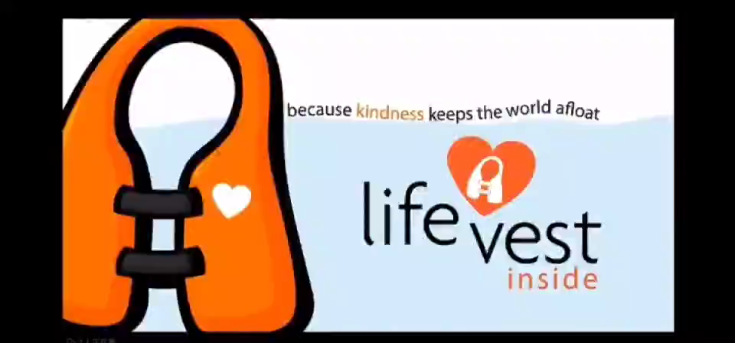

02

Slide 20
02
Sociocultural dimensions
1. The embodiment of civilization and progress
2. The contribution of a grateful society to respecting the fruits of labor
3. Promoting the emotional exchange and interaction between people

Slide 21
A keen sense of gratitude also plays an important role in personal growth.

Slide 22
02
Personal development dimension
1. Understand others and improve communication
2. Cherish resources and pursue dreams
3. Building good relationships

Slide 23
Let us cultivate a grateful heart, with a keen sense of gratitude to feel every beautiful moment of life, to build a more harmonious society and to achieve our personal dreams and goals.

Slide 24
What advice do you have for college students?
03

Slide 25
Tip 01
Enhance observational skills
Tip 02
Record heartwarming moments.
Tip 03
Tip 04
Self-reminding reflection
Enhance emotions with gratitude.

Slide 26
Thank you

